Slide 1
Spring Data Access Service

Slide 2
Spring Data Access Service

Slide 3
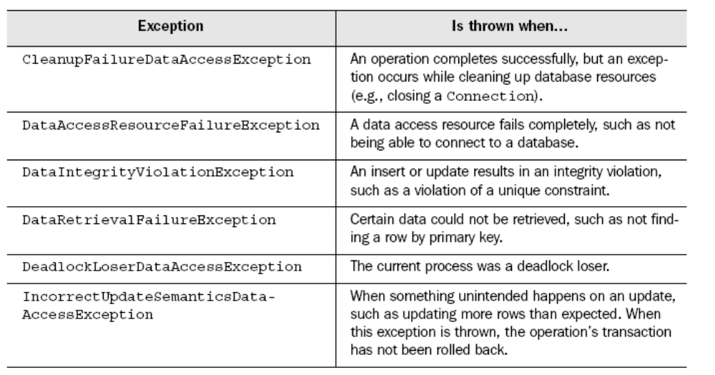
Spring Exception classification

Slide 4
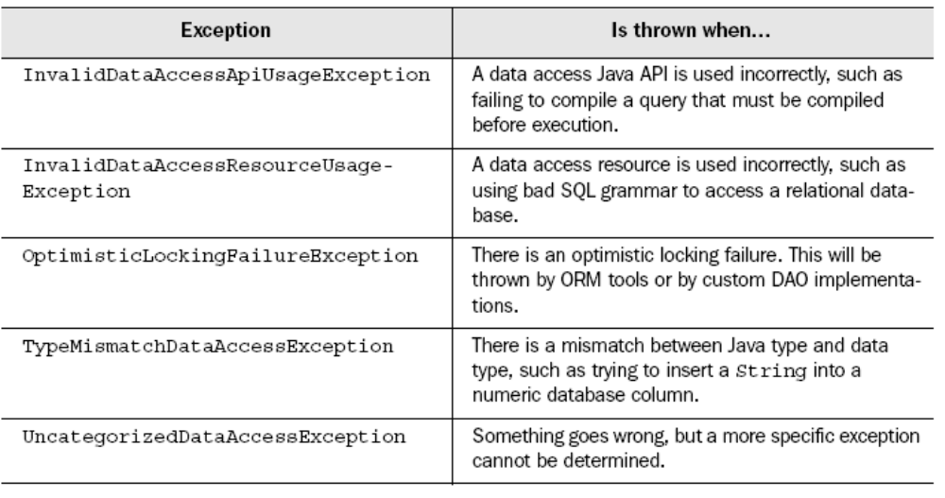
Cont …

Slide 5
Getting DataSource from JNDI
<bean id="dataSource"
class="org.springframework.jndi.JndiObjectFactoryBean">
  <property name="jndiName">
    <value>java:comp/env/jdbc/myDatasource</value>
  </property>
</bean>

Slide 6
DataSource ConnectionPool
<bean id="dataSource"
class="org.apache.commons.dbcp.BasicDataSource">
  <property name="driver">
    <value>${db.driver}</value>
  </property>
  <property name="url">
    <value>${db.url}</value>
  </property>
  <property name="username">
    <value>${db.username}</value>
  </property>
  <property name="password">
    <value>${db.password}</value>
  </property>
</bean>

Slide 7
DataSource for Testing
DriverManagerDataSource dataSource = new DriverManagerDataSource();
dataSource.setDriverClassName(driver);
dataSource.setUrl(url);
dataSource.setUsername(username);
dataSource.setPassword(password);

Slide 8
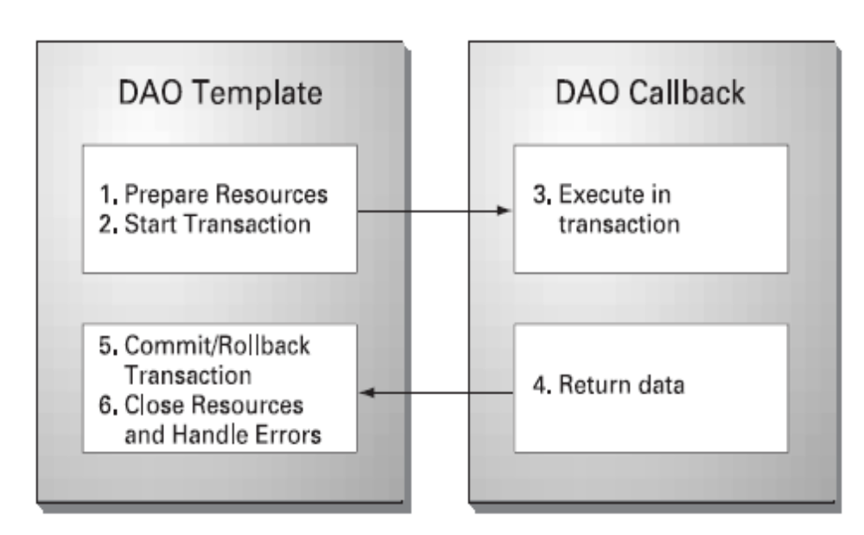
Spring’s DAO Template

Slide 9
JdbcTemplate
Spring JdbcTemplate will take care of Jdbc Resource management and error handling.
Spring JdbcTemplate class is thread-safe
DAO object needs JdbcTemplate to do its job

Slide 10
Configuration
<bean id="jdbcTemplate"
class="org.springframework.jdbc.core.JdbcTemplate">
  <property name="dataSource">
    <ref bean="dataSource"/>
  </property>
</bean>
<bean id="studentDao" class="StudentDaoJdbc">
  <property name="jdbcTemplate">
    <ref bean="jdbcTemplate"/>
  </property>
</bean>

Slide 11
Update or Insert in the DB
String sql = "insert into person (id, firstName, lastName) " + "values (?, ?, ?)";
Object[] params = new Object[] { person.getId(),
person.getFirstName(),
person.getLastName() };
return jdbcTemplate.update(sql, params);

Slide 12
Cont …
public int insertPerson(Person person) {
String sql = "insert into person (id, firstName, lastName) " +"values (?, ?, ?)";
Object[] params = new Object[] { person.getId(),
person.getFirstName(),
person.getLastName() };
int[] types = new int[] { Types.INTEGER, Types.VARCHAR, Types.VARCHAR };
return jdbcTemplate.update(sql, params, types)
}

Slide 13
Batching JDBC statements
public int[] updatePersons(final List persons) {
String sql = "insert into person (id, firstName, lastName) " +"values (?,?,?)";
BatchPreparedStatementSetter setter = null;
setter = new BatchPreparedStatementSetter() {
public int getBatchSize() {
return persons.size();
}
public void setValues(PreparedStatement ps, int index) throws SQLException {
Person person = (Person) persons.get(index);
ps.setInt(0, person.getId().intValue());
ps.setString(1, person.getFirstName());
ps.setString(2, person.getLastName());
}
};
return jdbcTemplate.batchUpdate(sql, setter);}

Slide 14
Reading Data
public Person getPerson(final Integer id) {
String sql = "select id, first_name, last_name from person " +"where id = ?";
final Person person = new Person();
final Object[] params = new Object[] { id };
jdbcTemplate.query(sql, params, new RowCallbackHandler() {
public void processRow(ResultSet rs) throws SQLException {
person.setId(new Integer(rs.getInt("id")));
person.setFirstName(rs.getString("first_name"));
person.setLastName(rs.getString("last_name"));
}
});
return person;}

Slide 15
Cont …
class PersonRowMapper implements RowMapper {
public Object mapRow(ResultSet rs, int index) throws SQLException {
Person person = new Person();
person.setId(new Integer(rs.getInt("id")));
person.setFirstName(rs.getString("first_name"));
person.setLastName(rs.getString("last_name"))
return person;
}
}

Slide 16
Cont …
public List getAllPersons() {
String sql = "select id, first_name, last_name from person";
return jdbcTemplate.query(
sql, new RowMapperResultReader(new PersonRowMapper()));
}

Slide 17
JdbcTemplate
public int getNumberOfPersons() {
  return jdbcTemplate.queryForInt("select count(*) from person");
}

Slide 18
Stored Procedure Support
public void archiveStudentData() {
CallableStatementCallback cb = new CallableStatementCallback() {
public Object doInCallableStatement(CallableStatement cs) throws SQLException{
cs.execute();
return null;
}
};
jdbcTemplate.execute("{ ARCHIVE_STUDENTS }", cb);}

Slide 19
Creating operations as objects
public class InsertPerson extends SqlUpdate {
public InsertPerson(DataSource ds) {
setDataSource(ds);
setSql("insert into person (id,firstName,lastName) "+"values (?, ?, ?)";
declareParameter(new SqlParameter(Types.NUMERIC));
declareParameter(new SqlParameter(Types.VARCHAR));
declareParameter(new SqlParameter(Types.VARCHAR));
compile();
}
public int insert(Person person) {
Object[] params = new Object[] {
person.getId(),
person.getFirstName(),
person.getLastName()};
return update(params);}}

Slide 20
Querying the DB using MappingSqlQuery
class PersonByIdQuery extends MappingSqlQuery {
public PersonByIdQuery(DataSource ds) {
super(ds, "select id, first_name, last_name from person " +"where id = ?");
declareParameter(new SqlParameter("id", Types.INTEGER));
compile();
}
public Object mapRow(ResultSet rs, int rowNumber) throws SQLException {
Person person = new Person();
person.setId( (Integer) rs.getObject("id"));
person.setFirstName(rs.getString("first_name"));
person.setLastName(rs.getString("last_name"));
return person;
}}
Object[] params = new Object[] { id };
return (Person) personByIdQuery.execute(params).get(0);

Slide 21
Spring ORM integration (Hibernate)

Slide 22
Mapping Hibernate Resources
<bean id="dataSource"
class="org.springframework.jndi.JndiObjectFactoryBean">
  <property name="jndiName">
    <value>java:comp/env/jdbc/trainingDatasource</value>
  </property>
</bean>
<bean id="sessionFactory" class="org.springframework.
orm.hibernate.LocalSessionFactoryBean">
  <property name="dataSource">
    <ref bean="dataSource"/>
  </property>
</bean>

Slide 23
Mapping hibernate Resources
<property name="mappingResources">
<list>
    <value>Student.hbm.xml</value>
    <value>Course.hbm.xml</value>
    …
  </list>
</property>

Slide 24
Another Way
<bean id="sessionFactory" class="org.springframework.
orm.hibernate.LocalSessionFactoryBean">
  <property name="mappingDirectoryLocations">
    <list>
      <value>classpath:/com/spring/training/model</value>
    </list>
  </property>
</bean>

Slide 25
Hibernate Template
<bean id="hibernateTemplate"
class="org.springframework.orm.hibernate.HibernateTemplate">
  <property name="sessionFactory">
    <ref bean="sessionFactory"/>
  </property>
</bean>
<bean id="courseDao" class="com.springinaction.
training.dao.hibernate.CourseDaoHibernate">
  <property name="hibernateTemplate">
    <ref bean="hibernateTemplate"/>
  </property>
</bean>

Slide 26
Hibernate Callback
public Student getStudent(final Integer id) {
return (Student) hibernateTemplate.execute(
new HibernateCallback() {
public Object doInHibernate(Session session) throws HibernateException {
return session.load(Student.class, id);
}
});
}

Slide 27
HibernateTemplate
public Student getStudent(Integer id) {
  return (Student) hibernateTemplate.load(Student.class, id);
}
public void updateStudent(Student student) {
  hibernateTemplate.update(student);
}

